Slide 1
Data Structures
Introduction

Slide 2
Data Structure
A data structure is a way of organizing and storing data so that it can be used efficiently.
Just like how you organize your clothes in a closet so that you can easily find what you need, a data structure organizes data in a computer program so that it can be accessed and manipulated quickly and easily.
Different data structures are used for different types of data and operations, and understanding them is important for writing efficient programs. Examples of common data structures include arrays, lists, and trees.

Slide 3
Choosing a data structure
The choice of data structure depends on the type of data being stored, the operations that will be performed on the data, and the constraints of the problem being solved.
Some data structures are optimized for fast insertion, deletion, or search operations, while others are optimized for efficient memory usage or ease of implementation.
Examples of common data structures include arrays, linked lists, stacks, queues, trees, and hash tables. Understanding data structures and their properties is essential for designing efficient algorithms and writing high-performance software.

Slide 4
Why we use DS?
We use data structures in computer programs to store and organize data in a way that makes it easy and efficient to access and manipulate.
Just like how a toolbox helps you keep your tools organized and easy to find, data structures help programs keep track of data in a way that's optimized for the task at hand.
Using the right data structure can make a program run faster, use less memory, and be easier to maintain and extend.

Slide 5
Why DS is necessary?
Data structures are necessary in computer programming because they provide an organized way to store and manipulate data, which is a fundamental aspect of nearly every computer program. Here are some reasons why data structures are important:
Efficiency: Data structures can be optimized for different types of operations, such as searching, sorting, and inserting, making it possible to perform these operations quickly and efficiently.

Slide 6
Why DS is necessary?
Organization: Data structures allow you to organize and manage large amounts of data in a way that is easy to understand and maintain.
Flexibility: Different data structures can be used for different types of data and operations, making it possible to handle a wide range of data types and processing needs.
Abstraction: Data structures provide a level of abstraction that makes it easier to write and maintain code. By hiding implementation details, programmers can focus on the behavior of the data structure rather than its implementation.

Slide 7
Why DS is necessary?
IF you want to be a good programmer:
Overall, data structures are essential for efficient and effective programming, and understanding them is an important part of becoming a skilled programmer.

Slide 8
what if we will not use data structures
If we don't use data structures in programming, it would be very difficult to store and manipulate large amounts of data in an efficient and organized manner.
Without data structures, programs would be less efficient, less flexible, and harder to maintain.
Here are some specific consequences of not using data structures:

Slide 9
what if we will not use data structures
Slower programs: Without data structures, it would be much slower to search, sort, and manipulate large amounts of data. Programs that rely on unstructured data would be much slower and less efficient.
Unmanageable code: Large amounts of unstructured data can be difficult to manage and maintain, leading to code that is more difficult to understand and update. Code that relies on unstructured data is more prone to errors and bugs.

Slide 10
what if we will not use data structures
Limited functionality: Without data structures, it would be difficult to perform certain operations, such as searching, sorting, and filtering data. This would limit the functionality of programs and make it more difficult to solve complex problems.
Overall, the use of data structures is fundamental to efficient and effective programming, and avoiding them would lead to slower, less flexible, and harder-to-maintain programs.

Slide 11
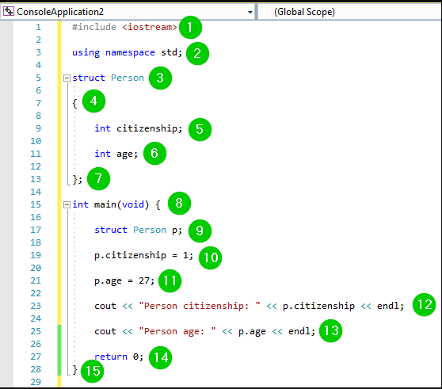

Slide 12
